Slide 1
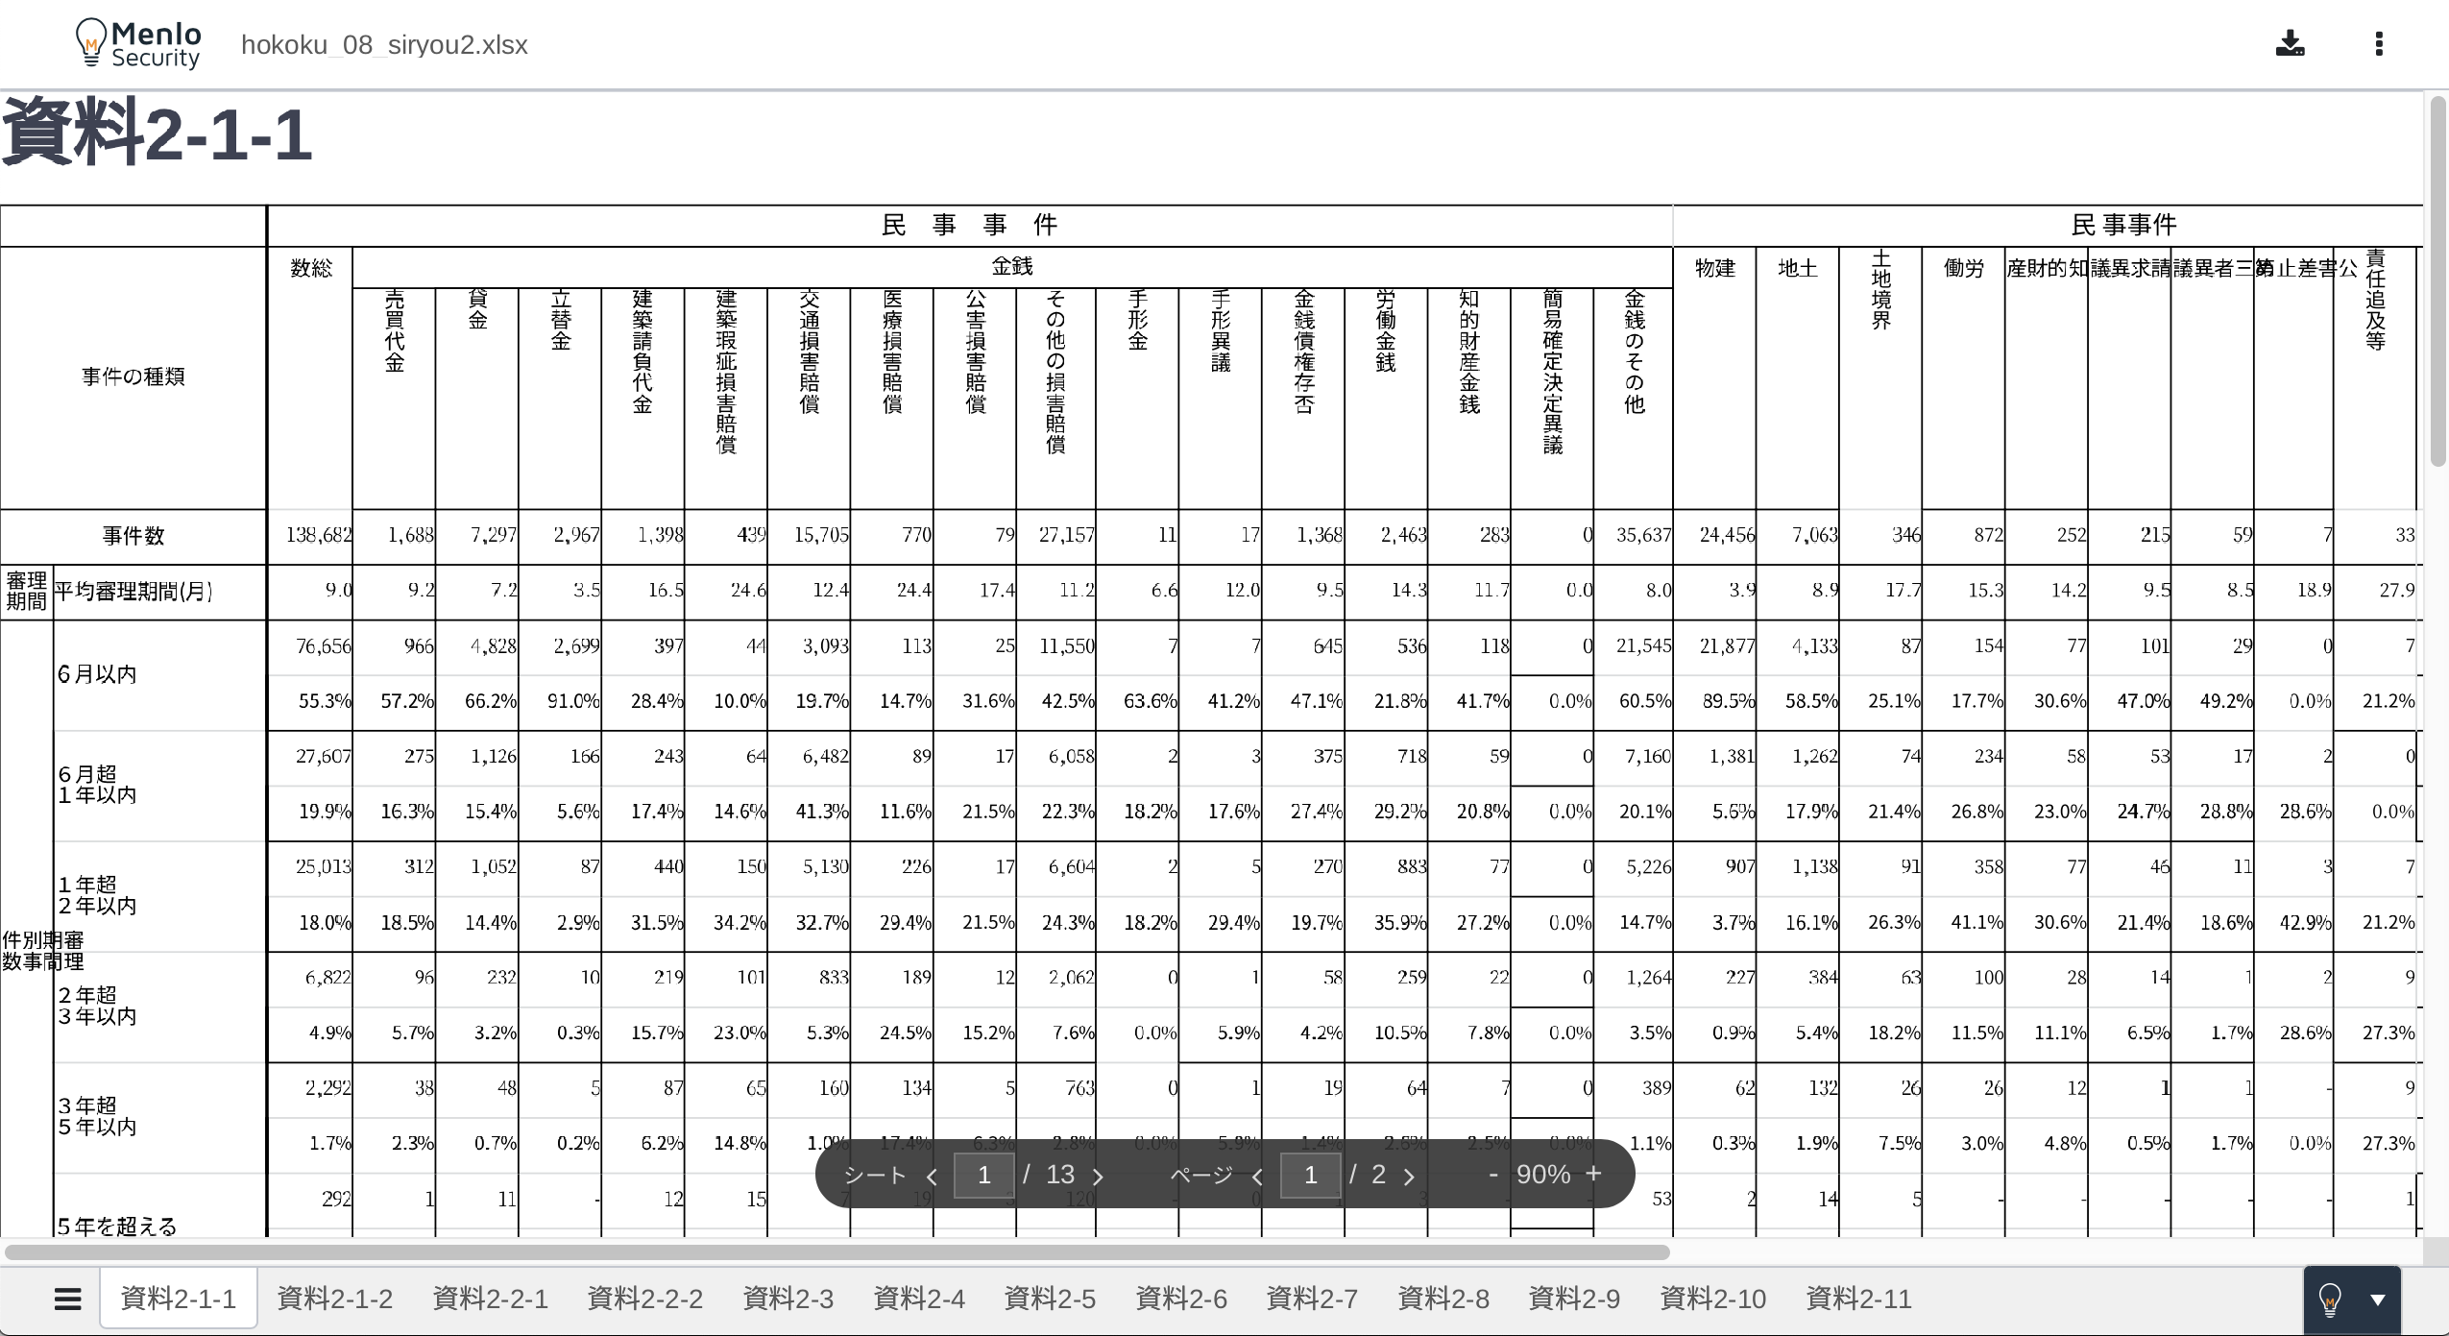
hokoku_08_siryou2.xlsx
These texts should be vertically written.
Borders should be correctly displayed.
There should be enough space for the 4 kanji characters.

Slide 2
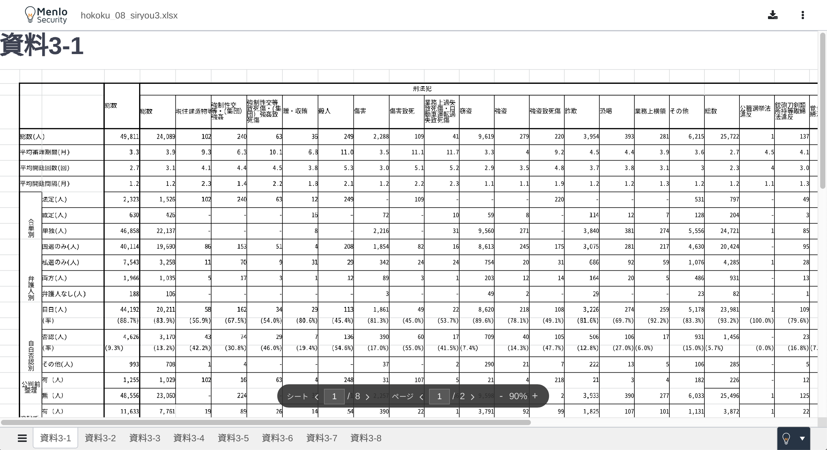
hokoku_08_siryou3.xlsx
These text should be centered and equally spaced.
Borders should be correctly displayed.

Slide 3
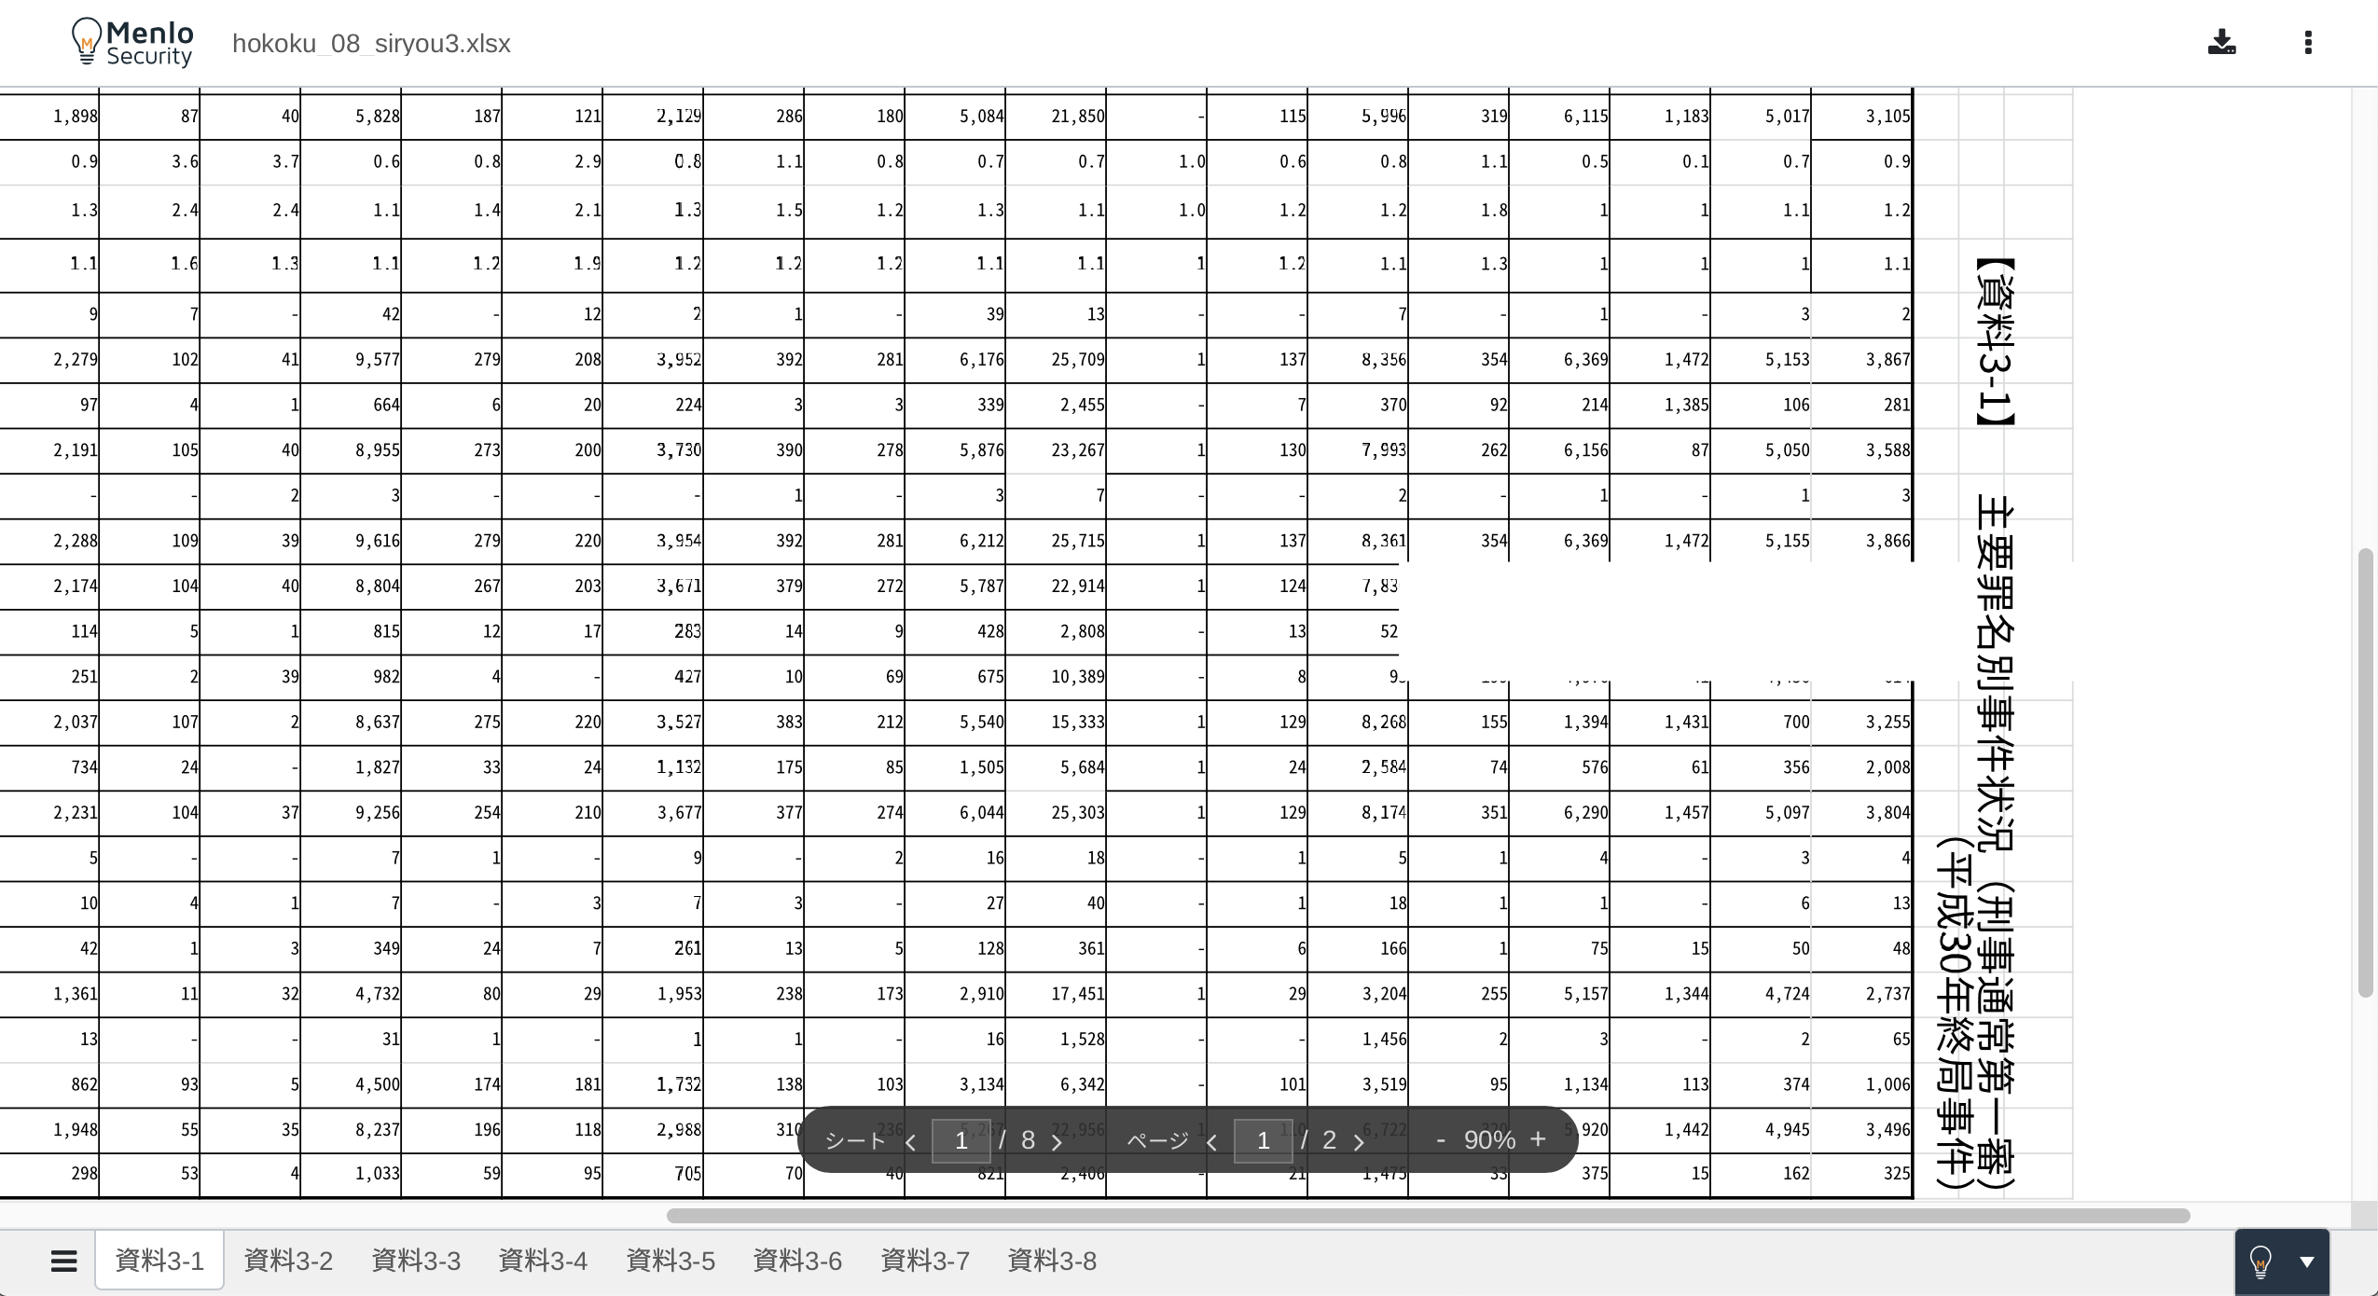
hokoku_08_siryou3.xlsx
This white space should not exist.

