Slide 1
Cyber Risk @ Barclays
RSMF Annual Conference 2014

Slide 2
Agenda
Quick overview of Barclays operations
Cyber Risk Management
Vulnerability & Threat Management
Summary of Approach
Q & A

Slide 3





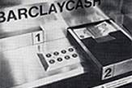

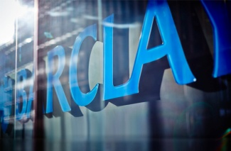


We’re an old bank
1690
1966
1986
2012
John Freame and
Thomas Gould start
trading as goldsmith
bankers in Lombard
Street, London
Barclaycard, the
UK’s first credit card,
is launched
Barclays is the first
British bank to list its
shares on both the
Tokyo and New York
stock exchanges
Pingit launched in the UK, allowing customers to transfer money via their mobile phone
1864
1967
2008
2013
Barclays builds a new
banking house in
Lombard Street, London
Barclays unveils
Barclaycash, the world’s
first cash machine, at the Enfield branch, London
Barclays purchases Lehman Brothers’ North America investment banking and capital markets businesses
Barclays launches its
Purpose and Values

Slide 4
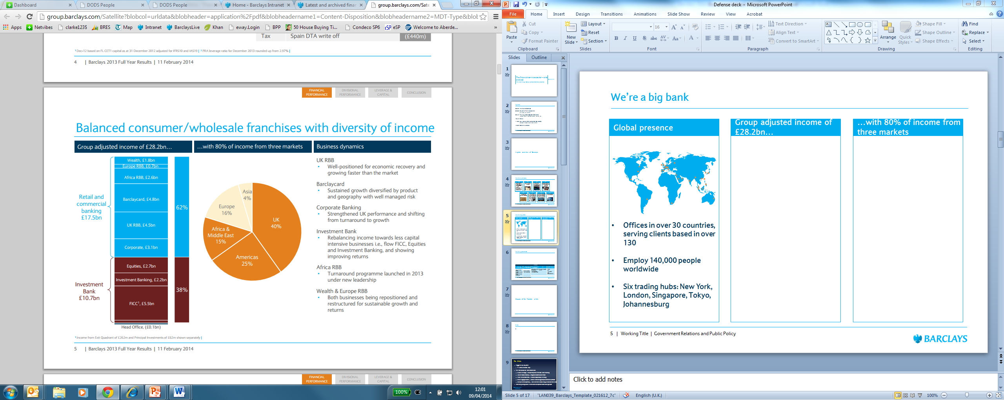
We’re a big bank
Global presence
Group adjusted income of £28.2bn…
…with 80% of income from three markets
Operating in over 50 countries, serving clients based in over 130
Employ 140,000 people worldwide
Six trading hubs: New York, London, Singapore, Tokyo, Johannesburg

Slide 5
Landscape of Risk
Asset
Landscape
Controls
Landscape
Risk
Threat
Landscape
Loss
Landscape
5 | Barclays | Cyber Risk

Slide 6
ERMF: Cyber Key Risk Governance
Cyber Risk Control Framework
Cyber is a Group Key Risk
Managed through Cyber Control Risk Framework
Cyber Risk focuses on “attacks”
Risk Appetite to be set at Business Unit and Group level
Direct and Set Risk Appetite
Cyber Risk Policy
Standards: Threat and Vulnerability Management, Threat Simulations, Investigations
Set and Monitor Controls
Key Risk Indicators
Cyber Risk Management Processes and Tools
Key Metrics
Cyber Risk Assessments
Cyber Controls Assurance
Internal Audits
(BIA – 3 LoD)
Evaluate
The status of risk is assessed by reviewing multiple sources of risk data (both self assessment and independent review)
This data is analysed to identify risk themes which drive improvement actions within Cyber Risk
Risk Events
Conformance Testing/Review
ERMF Elements
Risk Analysis and Action Tracking
Output
Respond
Pervasive Control Issues
Cyber Risk Profiles
Oversight
KRO Challenge and Review
Group-level oversight of the profile and direction of Cyber Risk performed by the Cyber Key Risk Forum
Monitor
Cyber Risk Key Risk Forum
6 | Barclays | Cyber Risk
Notes:
6

Slide 7
Cyber – Connection with Fraud & Financial Crime
Cyber
Malicious attempts to break Financial Crime Systems
Fraud
Financial Crime
Large overlap in “connected” technology fraud (attacks on customers)
Financial Crime, Fraud Operations and Business Unit Fraud - Risk Investigations
Fraud operates at the following levels:
Strategic – Second Line of Defence
Operations – First Line of Defence
Business Unit – First Line of Defence
Some overlap (mainly touch points) across both Cyber and Fraud Risks.
Financial Crime may be the impact / outcome of a Cyber and Fraud / Cyber or Fraud incident or risk
Internal (Business Unit / Group wide) intelligence sharing
Externally gathered intelligence sharing
Historic incident / event lessons learned
Key Risk Scenarios
7 | Barclays | Cyber Risk

Slide 8
Cyber Risk vs. Technology Risk (2nd Line of Defence)
Sub-Risks
Attacks on our Customers
Attacks on Us and our Partners
Attacks against Service Availability
Attacks against Critical Banking Infrastructure we depend on
Sub-Risks
IT Operations: Non-availability of IT systems
IT Change: Inadequate design, testing and implementation of new and changed IT solutions
IT System Security: Inadequate IT system security. The risk of unauthorised access to IT systems, resulting from inadequate IT systems security
8 | Barclays | Cyber Risk

Slide 9
Asset Landscape vs. Control Landscape
Most Valuable Assets & High Risk Groups
Critical Applications & Infrastructure
Everything Else
Identify & Prioritise
Enhanced Controls
Attacker cost
Minimum
Standards
Digital Assets (includes suppliers)
9 | Barclays | Cyber Risk

Slide 10
Megatrends
  Minimum Viable Product: shrinking time to market disrupting software development lifecycle, operations and security assurance
  User experience: Customer Journey (vs. Threat Actor Journey)
  Digital insights: data sources, volume, signal vs. noise, data scientists
  BYOD, Mobile, Cloud: 3 tech and workplace forces reshaping how we think about risk and control
  3rd party risk: supply chain risks; e.g. Target breach
  CyberInsurance: XLS vs. signals intelligence
  Cyber Skills...
10 | Barclays | Cyber Risk

Slide 11
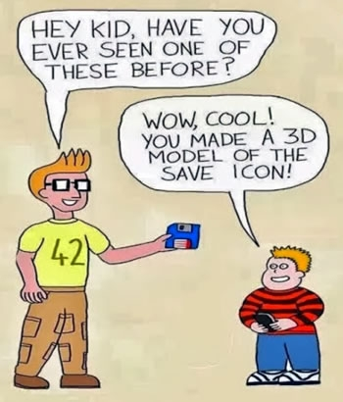
Cyber Skills
11 | Barclays | Cyber Risk

Slide 12
Traditional InfoSec
  Extensive system hardening
  Heavy perimeter defences & detection
  Technology aligned penetration tests
  Segregated physical and infosec ops
  Practitioners apply their own risk appetite
  Threat intelligence == "nice to have“
  Secops BS (Big Screens)
  Fix all the things: harried defenders, “Just say No”
  Striving for Perfection vs. Purposeful Survivability?
12 | Barclays | Cyber Risk

Slide 13
Vulnerability Management
  Breadth vs. Depth: at scale vs. Channel specific
  Goals: complete? Patch what's important? Compliance?
  Vulnerability Identification
    false positives vs. false negatives
    Static vs. dynamic checks
    Infrastructure, commercial apps, in-house apps, endpoints, “other”
13 | Barclays | Cyber Risk

Slide 14
Vulnerability Management
  Vulnerability Analysis (aka what to patch?)
    CVSS...
    Economic impact?
    Critical/High vs. Medium/Low?
    Attack chains: how many low risk vulns does a high risk make?
    Exploitability index?
    Proof of concept code availability?
    Present in criminal kits?
    For sale on the underground exploit market?
    Trust relationships: explicit and implied
    Operational risk of patching
14 | Barclays | Cyber Risk

Slide 15
Innovation: Protecting the upside
  What is the business risk appetite? Markets differ, competition varies, winner takes all?
  Minimum Viable Product: Learning through failing (closed?)
  How to handle new technology with fresh, shiny and unknown attack surface?
  Trade off between security assurance activities and speed to market
  What is the right balance between investment in upfront protective and detective controls?
  Instrument services heavily, build a baseline and detect anomalies in real time?
  Piggy back Continuous Deployment to “hot patch” as part of Incident Response strategy (OODA loop)
  What about non-traditional tech....wearables?
15 | Barclays | Cyber Risk

Slide 16
Threat Management: Protect, Detect, Respond
  What does Success look like? (Link to Risk Appetite)
  What are you protecting? (Link to “Most Valuable” to us)
  What is “Most Valuable” to your intruders? (Critical Infrastructure, Access to 3rd party connections?)
  What signals are you assessing and what are your triggers? (outbound C2 polling? Netflow? DNS? 3rd party data dumps? SQL errors in application logs? Traffic mix? IP blacklists matched against channel activity?)
  What actionable insights are you getting from your existing data sources?
  How do you learn from prior events?
16 | Barclays | Cyber Risk

Slide 17
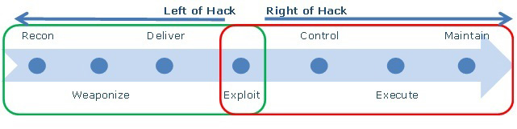
“Left a bit”: Cyber Kill Chain – Lockheed Martin
17 | Barclays | Cyber Risk

Slide 18
Threat Simulations
  Red Teaming vs. Penetration tests
  Broad in scope, yet specific business focused goals ("crown jewels")
  Ask your CIO: "what keeps you awake at night”
  Characterise the threat and act it out
  Drive improvements in protect, detect, response
    breach simulations: assume you’re vulnerable (who isn’t?)
    tabletop vs hands on
  Simulations make reality plastic; passports, Denial of Service
  Process hacking
18 | Barclays | Cyber Risk

Slide 19
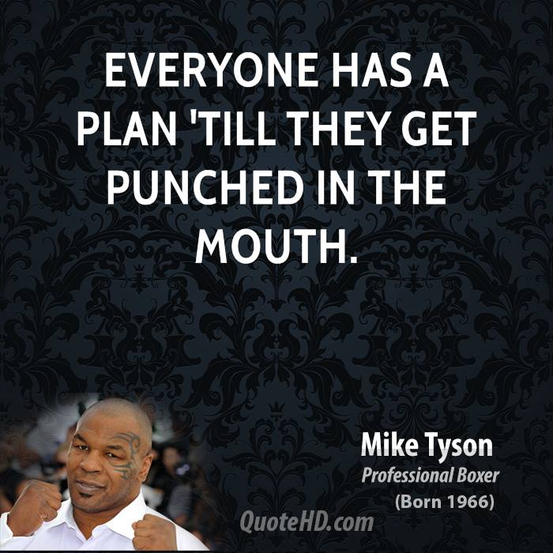
Incident Response
  Situational Advantage vs. Attacker Dilemma
  Containment?
    Speed (time to respond vs. contain)
  Persistence mechanism identification
    Baseline
  How long to hover over the Kill switch?
19 | Barclays | Cyber Risk

Slide 20
Check and Challenge
Are we capturing the right data to measure our Key Risk Indicators?
Deep dives on Risk “Events”
Are our policies aligning incentives and driving responsible risk tasking within appetite?
Are we effectively increasing the costs of our attackers whilst managing our own?
Do we have the right capabilities in the right places?
20 | Barclays | Cyber Risk

Slide 21
Cyber Risk Approach - Summary
  Threat Centric: understand our foes, their goals and attack patterns (kill chain analysis)
Agile controls: instrument broadly & use lean data science, Threat Intel and Risk Appetite to drive focused approach to control scope & design
Run broad scope, goal oriented Threat Simulations to drive continuous improvements in Protection, Detection & Response
Protect the upside: design controls with our Digital Office agenda front and centre
21 | Barclays | Cyber Risk

Slide 22
Q & A
  craig.balding@barclays.com
22 | Barclays | Cyber Risk

