Slide 1
“How would you engage and enthuse a fragmented publishing community to make sure they buy into our standards and governance?”
To do

Slide 2
RENEW
Please Get ^{Everyone} With The
Publishing
Notes:
I would like talk about the Renew Program and how Nationwide as an organisation needs to get behind it to energise
Your intranet ,
its goals,
its contributors and consumers
to work toward a much better place to find content.
And thus the underlying governance model

Slide 3
assumptions
I AM gUESSING
Maybe this is too much
Notes:
I have made assumptions
Guesses too
And maybe I have gone to far with this but here we go!

Slide 4
”Create one, high-performing company to be the best financial provider for our customers, through informed and engaged employees, who are clear about the direction of the business and feel proud to belong to Nationwide”
  Make Good Decisions
    Innovate
      Create High Performance
    Build Collaboration
  Be Agile
Notes:
Assumptions:
The need to support the overall Goal like this
To uphold your Nationwide behaviours like:
Make Good Decisions – based on key information
Innovate - think about the future creating new solutions to achieve competitive edge
Create High Performance – raise the bar across the business, holding others to account, provide feedback and support
Build Collaboration - recognise we are interdependent and work together
Be Agile – respond effectively to change and help others embrace change

Slide 5

So the publishing staff are Key to company
Notes:
And we must remember that at the heart of any intranet operation that
Content is king
So the publishing community are the key resource
Without them no “product” as it were

Slide 6

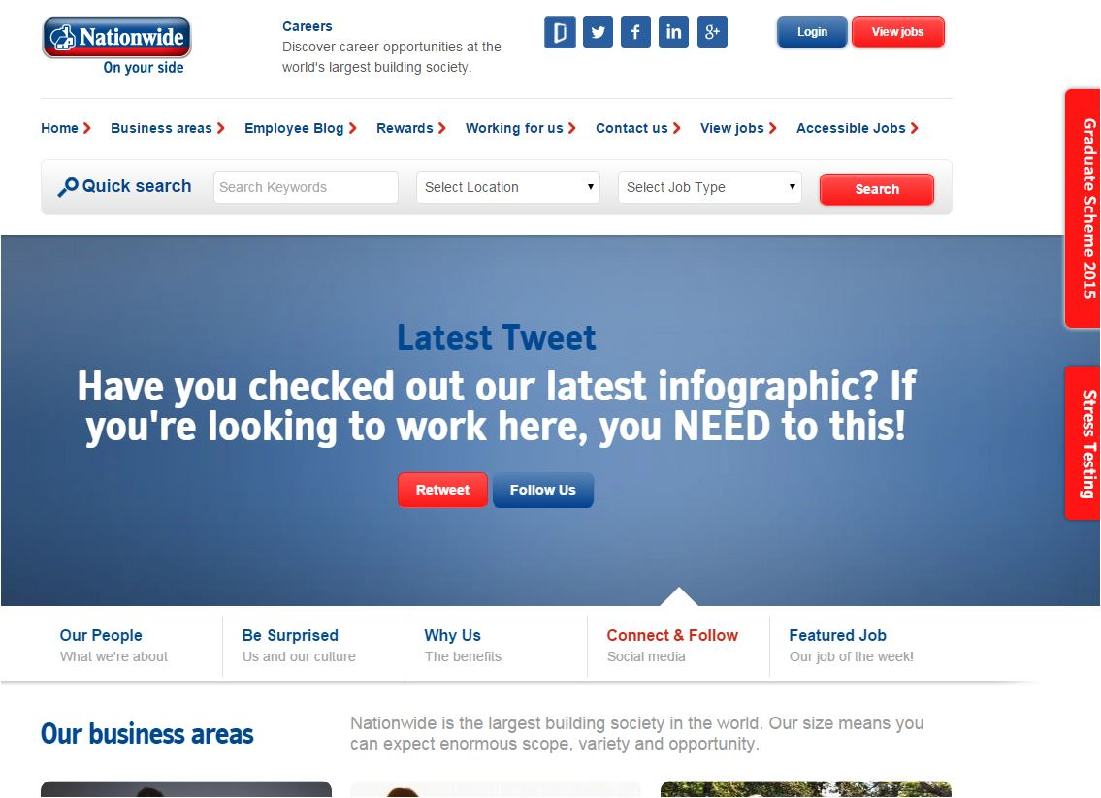
We
liked
this
Notes:
You LOVE what you had a while back –
I know its not your internal view buts its all I had to work with
I am sure the
initial feedback was good
use was good
Content was good

Slide 7
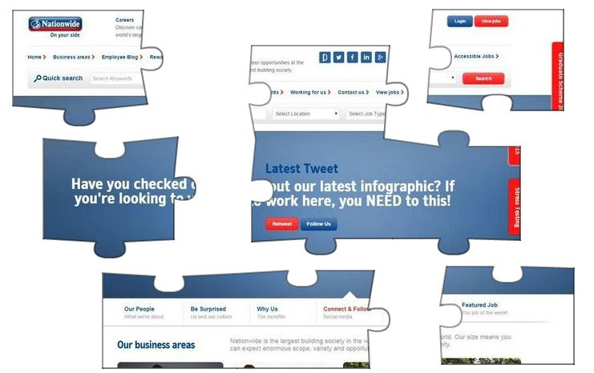
OOPS
Fragmented publishing
Low quality
Hard to find
Local stores emerging
Notes:
The are areas of concern could be
Publishing has become fragmented , producing below par content –
its relevance maybe questionable,
its quality lower than expected
its hard to find as its not produced wrt standards within the governance model
There maybe even some consumers creating their own local content that is limited in its access

Slide 8
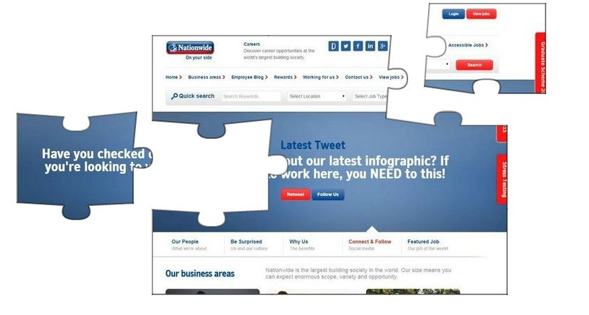
Maybe it’s not that bad
Notes:
But maybe its NOT that bad really, could be just a few areas of concern

Slide 9
Working “iHARMONY”
???
Good GOVERNANCE
a little Chaos
FRAGMENTED
HEALTHY GROWTH
Site Launched
Notes:
Like a lot of other organisations, you:
Progressed from exciting launch
Through to useful content for consumers
But then content creation goes crazy – to much, not well written, and consumers can’t find anything, some content being stored local to specific departments
So you designed and applied a governance framework
Which got your valuable content back on track, consumers happy again
And then publishers became overwhelmed with volume, timescales - mean corners cut so standards and compliance cut
Some publishers feeling isolated or lack of ownership, lack of feedback from consumers
It all becomes FRAGMENTED and that’s costing the company as staff consumers aren’t being supported as well as they could be.
Consumers are not finding what they want, and they probably want to communicate in new ways
So the question is - how to reach intranet HARMONY again so that your intranet is meeting its specified goals, so the consumers are getting what they want to enable them perform in their jobs EASILY so that Nationwide PERFORMS as the best financial provider to their customers.

Slide 10
Working “iHARMONY”
How do we
Notes:
How do we get from
the fragmented publishing so that Nationwide has a
balanced,
evolving,
adaptable place where useful content supports the staff
and new sparks of innovation may fly to find new ways of working

Slide 11
RENEW
toward
Working “iHARMONY”
Enable Conversations
Engage Communities
New Agility
Review Governance
Notes:
I am proposing a set of initiatives covering both the now and longer term – they cover both the producers and also the consumers
look to RENEWING what you have work toward a place that has USEFUL content, engaged publishers and increased consumer collaboration which will produce interesting results
Remember that CONTENT IS KING, the publishers are key to driving forward new initiatives, we have to make them feel good about what they are producing again,
they are at the heart of the site. They have to feel like they are the MOST important part of the organisation
They need to drive: Look at current goals and model, what works, what doesn’t Forming their own living communities – helping each other, encouraging consumers to add value Understand and look at what other organisations have achieved by changing their process to deliver better content and happier publishing resources
Encourage and Enable consumers to become micro producers and kick start a wave of new collaboration revolving around more conversational interaction – this should alleviate some pressure from traditional publishers, but also grow the whole content community
.

Slide 12
Working “iHARMONY”
Revisit Goals
Review People
Analyse Standards
Understand Content stores
Reengineer
Enable Conversations
Engage Communities
New Agility
REVIEW GOVERNANCE
Notes:
Turning its on its head away from the governance group – put the publishers in charge for a while,
Have them Take a long hard look at roles, process, standards, start counting views, analyse your metrics and any other feedback(maybe polls for written feedback about content provided) – what else would they like to see – highlight the good, bad and the ugly
Governance isn’t just about a management structure, it is also concerned with the ongoing quality of content and the user experience on the intranet.
Do any of these require changes:
What are the objectives of the intranet?
What roles and what are their responsibilities?
What intranet standards and processes do we have?
How do we form and maintain good intranet practice?
What content do we have, is it useful, where is it stored and does it conform
Then take all this information and rework the governance , the roles, the processes, the standards where necessary.

Slide 13
Working “iHARMONY”
Publisher Education
Publisher Community and Collaborate
Publisher Accountability and Reward
Consumer Influence
Enable Conversations
ENGAGE COMMUNITIES
New Agility
Review Governance
Notes:
And to underline that publishers are key - Make them central to the intranet community
Take highlights from review
Take any feedback and metrics
and retrain publishers, setup workshops, self help within the community
Have publishers form communities to share best practice and discuss issues – they will help each other and become self governed
Have them propose ideas for measuring accountability, what happens when not performing, how and when to reward
They need to understand that bad feedback, will be discussed during appraisals – document the competencies to cover this
But then on the positive side, celebrate and reward , looks at simple things like Show case Page / content of the month, by stats or consumer feedback
Maybe they will decide on some minimal rewards - Recognition Incites Engagement and Contribution
Encourage consumers to add comments, reviews, tags, likes - get them involved providing feedback, it’s a valuable source of information to make changes and monitor publishing quality and standards.
And make it FUN

Slide 14
Working “iHARMONY”
agile Publishing Community
“more about being agile,
than doing Agile”
Empower Publishers
Empower Consumers
Enable Conversations
Engage Communities
NEW AGILITY
Review Governance
Notes:
This maybe happening already but if it isn’t then I think having publishing take on new project management style would prove very beneficial to their community, becoming more agile, a couple of quotes
The effect was that individuals held themselves accountable for specific tasks, and everyone knew what was going on. Eventually the army left, but that short time of working together “empowered a bunch of civil servants”.
Accelerate publishing while improving quality, and process
Quick overview of process and benefits:
Agree on deliverables and quality = Improve consumer involvement and quality
Produce content in short cycles = reduced time to deliver
Build in validation by consumers = consumers get what they want/need
Review cycle to identify working practices = publishers and consumers help each other to improve content deliver
Value proposition:
Highly visible as both publisher and consumer working together Adaptable as refinements always possible Low risk as short cycle delivers “correct” content, while everyone working together Teams learning new approaches to working which is applicable for anything Good business value
I witnessed how changing to this model not only increased our pace of delivering new features, but also improved the quality of the final product. I was thrilled to see the team transform into a cohesive group of committed, empowered, dynamic teammates who revelled in their delivery of product.

Slide 15
Working “iHARMONY”
Allow a Little “chaos”
Drive Conversations and experimentation
  “Let the sparks fly”
ENABLE CONVERSATIONS
Engage Communities
New Agility
Review Governance
Notes:
This is big one, maybe a step to Far, may already happening
Allow People to Contribute content as Well as Read It Trust your employees to work together productively, not time-waste
Encourage a little chaos
Allow “local sites”, let the owners drive the content, the colour, the style
Provide “tools” for discussion, conversations
To take account of different content types and user needs, you really need different governance models running in parallel with differing levels of control along a spectrum:
Governance with lots of control and then the opposite of control
drive for control of intranet content over the last few years – fuelled by sound business reasons – we’ve stifled innovation and creativity and decoupled experimentation from core intranet platforms
There are clear organisational benefits to social; Employee happiness – the return on community Humanizing work Building collective intelligence
More effective new employee on boarding You become real to your colleagues You can take charge of when and how you work You can overcome formal support borders You can give (and receive) thanks and credit You can establish direct relationships and strengthen ties

Slide 16

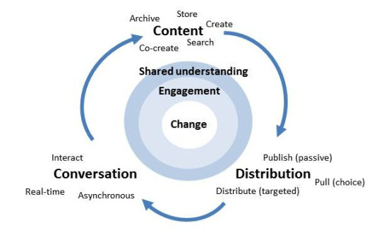
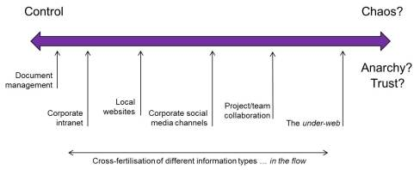
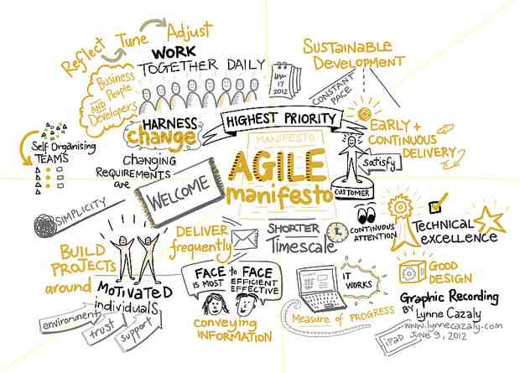
Working “iHARMONY”
Productive publishing
Living content
Working conversations
Notes:
This is the question how to reach HARMONY again so that your intranet is meeting its specified goals, so the consumers are getting what they want to enable them perform in their jobs so that Nationwide performs as the best financial provider to their customers.
HAPPY publishers, accountable, rewarded, new working practices , working in communities helping each other
Content that’s alive, relevant and everyone is involved, that covers “traditional” reference items, but now there is a place for people to collaborate in a more social way and who knows what maybe be born out of that - they will find new ways of working with each other, with clients, suppliers………..
It should be a healthy balance of: stuff (collectively described in this diagram as ‘content’) -> getting to the right people in a timely fashion -> creating conversation -> which helps inform the next load of stuff … and so it goes on. Traditionally, we have been poor at the conversation bit of this which I think has limited the value we’ve delivered as a profession. However, with the advent of the so called social organisation, this is all changing. Once we’ve got this all ticking along nicely we can be assured that we all have a shared understanding of what is required, we feel engaged and change happens. If only it was that simple!

Slide 17
Review Governance
Engage Communities
New Agility
Enable Conversations
Working “iHARMONY”
Notes:
5 themes, to RENEW your intranet value to the business,
enthuse publishers,
enable consumers to support you business so that you can provide an even better product to your customers.
Manage what you’ve got
Retrain, reward and encourage publishers to help each other
Enable publishers and consumers to be more agile, more accountable, more responsive
Let the sparks fly, lets see what social content can do for you as an organisation
Then the company will be working together to support itself and its customers

Slide 18
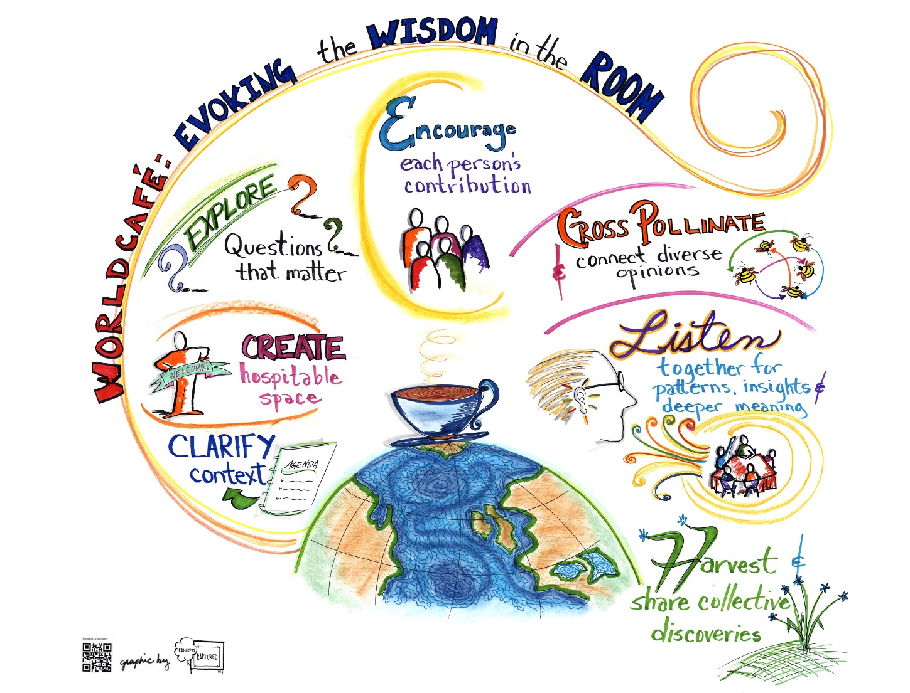
Working “iHARMONY”
do you have Any Questions

Slide 19
THANKS

Slide 20
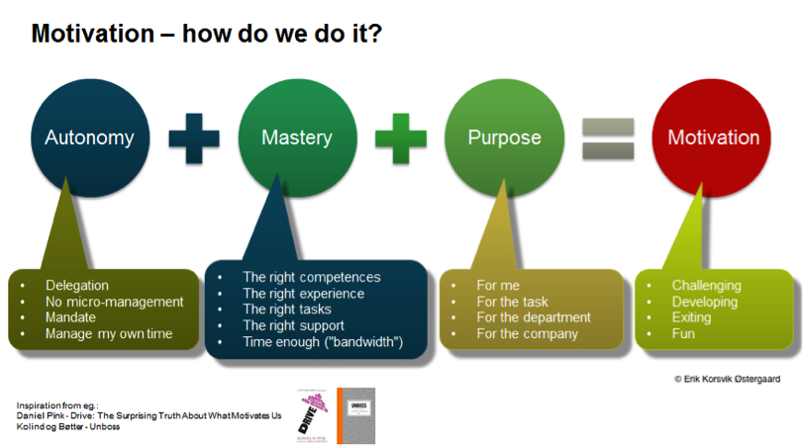



Slide 21
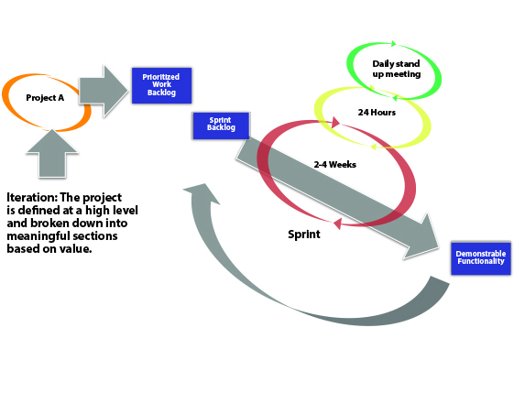
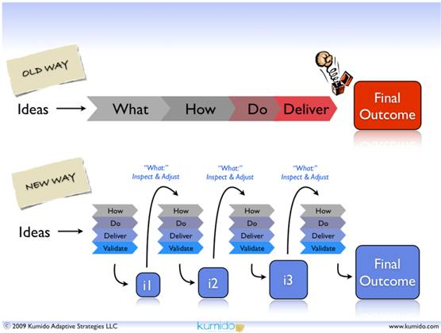
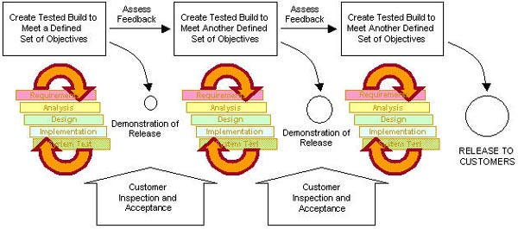
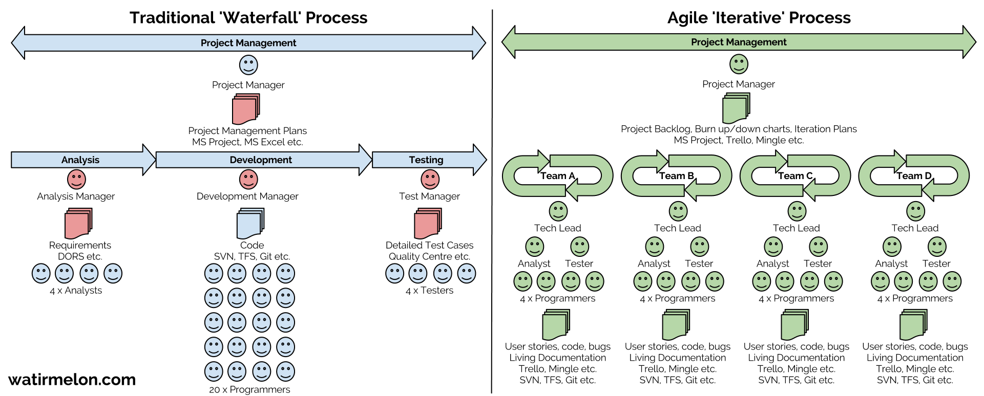

Slide 22
The intranet steering committee ensures the appropriate balance is achieved between the requirements of users, the resources allocated to the intranet and the overall requirements of the business
The intranet sponsor is someone who can align the objectives of the intranet with the objectives of the organisation. They will help gain access to both financial and human resources that the intranet may require.
The intranet manager is ultimately the owner of the intranet and will coordinate the overall functioning of the intranet on a day to day basis. They will focus on ensuring the intranet operates as an effective business tool.
Most intranets enable everyone to contribute content to a certain degree. Within your intranet governance document you should set out any conditions or checklists that need to be followed when contributing
The content owner and approvers are individuals who are responsible for keeping their own departments information updated. This is usually business information (such as news) or department information (such as events).
Editors need to control the quality of the content based on the standards set out by the organisation. This may mean making sure business content is produced in a consistent tone of voice or using a specified style.

Slide 23
Notes:
THOUGHTS ON SHAREPOINT GOVERNANCE
Nothing seems to attract attention more these days to a blog post than sticking the wordsSharePoint and governance in the title … without wishing to jump on the bandwagon – actually, jumping firmly on the bandwagon with a double backwards flip and triple salco thrown in – here are my thoughts to add to the cascade of information on the subject.
[To be honest, what follows is not specific to SharePoint but you’ve got to grab attention where you can! :-) ]
Anyway … it seems to me that when people talk about intranet governance they seem to view the intranet as a single amorphous blob which needs to be governed (read controlled) in one way. To me, this misses a whole spectrum of nuances around user needs and normally results in an overly restrictive governance regime designed for top-end, formal content being imposed across all content types and all user needs (see previous posts on the subject of differing content types:Changing nature of intranet content; and Content types should complement not compete).
To take account of different content types and user needs, you really need different governance models running in parallel with differing levels of control along a spectrum – a kind ofcontrolometer if you like … at one end: total control; and at the other: the opposite of total control … whatever that is … anarchy; chaos; trust – you choose!
As an aside, there’s one content type I’ve listed which might surprise people – the under-web. It strikes me that in the drive for control of intranet content over the last few years – fuelled by sound business reasons – we’ve stifled innovation and creativity and decoupled experimentation from core intranet platforms driving it under desks where it is extremely difficult to benefit from the great things which go on in these spaces. We should always legislate for experimentation in our governance models.
A final point, content types shouldn’t be kept apart in a kind of quarantine from each other … there should be exposure and cross fertilisation of different content types both to the left and right of the spectrum to generate valuable context.

Slide 24





People are key
Notes:
Ask them what they need
The intranet is a key tool in enabling the business to achieve the goal of insert your business objective here.
The intranet also assists the business in achieving the following objectives:
• Providing employees with the ability to do their work more efficiently and effectively
• Allowing more precisely targeted, relevant communication and interaction with employees
• Enabling employees to be clear about the direction and purpose of the company
• Ensuring employees understand how they play a part in the success and performance of the business
• Giving employees reasons to feel proud to belong to the business
• Ensuring the communication across the company is consistent in message, scheduling, style and tone

Slide 25
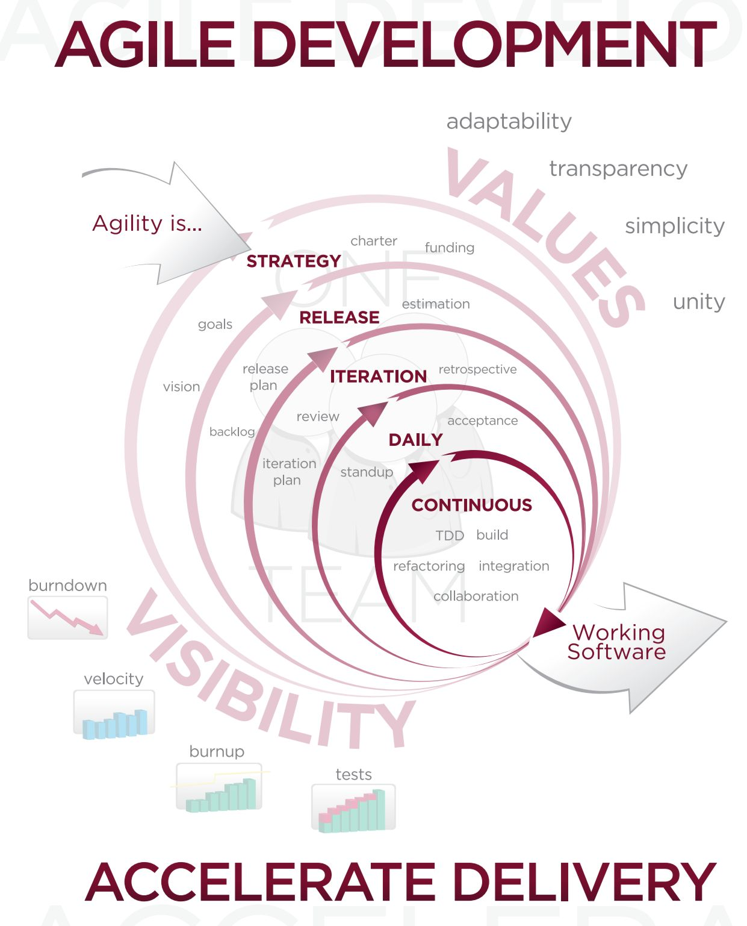
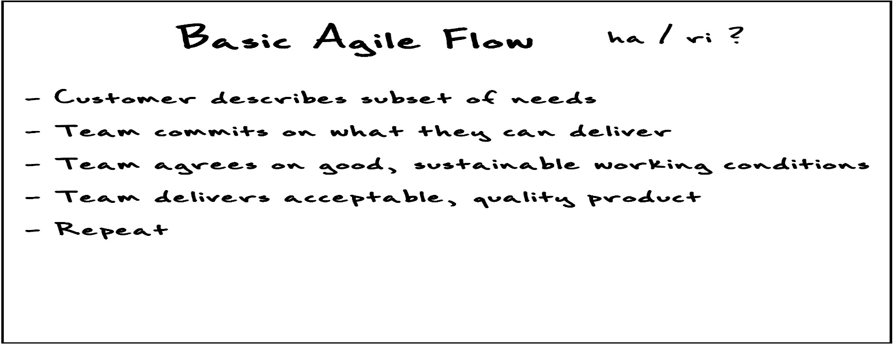
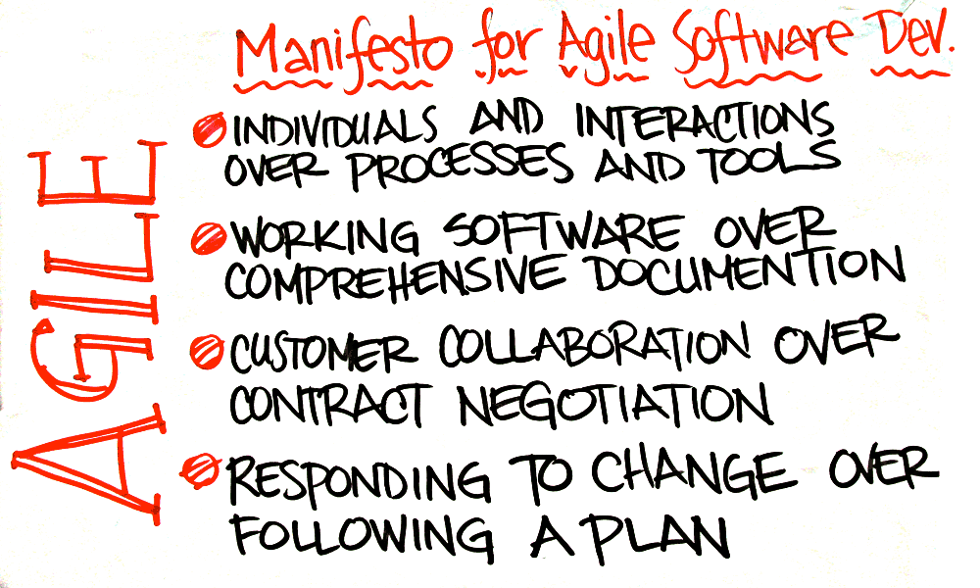
Notes:
It all started when I was the CTO of a growth-stage software company and implemented Agile Scrum to increase our product development efficiency and effectiveness. I witnessed how changing to this model not only increased our pace of delivering new features, but also improved the quality of the final product. I was thrilled to see the team transform into a cohesive group of committed, empowered, dynamic teammates who reveled in their delivery of product. Based on this success, I took Agile practices to the company’s professional services team, and even to the executive team, as a way of accelerating business velocity.
1) Our highest priority is to impact the audience throughtimely and continuous delivery of valuable content.
It all starts with the audience, the buyers, and the consumers, and delivering valuable content to them where and when it will have impact. This is the mission of content marketing and takes its worthy spot as the first principle.
2) Welcome changing requirements, even late in content creation. Agile processes harness change for competitive advantage.
It is never too late to halt or change the creation of a piece of content. It will happen – a customer case study will be compromised by an account management issue, a competitor will beat you to the punch on a thought-leadership topic, or the market context will shift and make your white paper outdated. It is far better to shift gears even at the last minute than to deliver something misaligned or irrelevant. Welcome the opportunity to get it right rather than be frustrated over the causes of change.
3) Deliver content frequently, from a couple of minutes to a couple of months.
Each channel or media format has its own nuances and time cycles for creation and consumption. From spontaneous social posts to long-form white papers, be clear and realistic about delivery-time cycles and expectations.
4) Business people and content creators must work together daily throughout the project.
Continuous dialogue around prioritization, progress, roadblocks, and needs with an informed and empowered delegate from outside the content team is essential to keeping the factory running at full steam. In software development, this role is filled by the product manager. In content marketing, this role is typically filled by the managing editor.
5) Build projects around motivated individuals. Give them the environment and support they need, and trust them to get the job done.
Software developers and writers share many traits. They need to blend creativity with science. They need to collaborate, yet go heads-down with focus on their individual tasks. And they don’t like people looking over their shoulders and micromanaging them. Figure out what your content marketing team members need to be successful, provide it, and trust their commitment and motivation to get the job done.
6) The most efficient and effective method of conveying information to and within a team is face-to-face conversation.
Ever notice how an internal email about a content asset can have 10 times as many words as the content asset itself? This is all too common and inefficient. Conversations – not more emails – will cure this inefficiency and remove ambiguity and misunderstanding among content creators and their subject-matter experts, product managers, etc.
7) Impactful content is the primary measure of progress.
Impact will be measured in different ways for different teams. But progress should be measured in metrics that drive the business and revenue, such as leads, conversion, sales, up-sells, and cross-sells, etc.
8) Agile processes promote sustainable development. The sponsors, content marketers, and audience should be able to maintain a constant pace indefinitely.
A well-tuned factory can produce at a predictable, sustainable, and high-throughput capacity. Sustainability prevents burnout on the team and loss of quality at deadline crunch time. It is also important to think about sustainability of the audience. Why generate more content than the audience can actually consume?
9) Continuous attention to writing excellence and goodproduction practices enhances agility.
High standards for writing lead to lower editing costs, better reusability, and an overall faster completion time. Likewise, rigor on asset production makes repurposing, rebranding, and content updates much more efficient. Can you repackage all your collateral with one update to a template? If not, there is a lack of efficiency to be fixed.
10) Simplicity – the art of maximizing the amount of work not done – is essential.
Keep things simple, avoid unneeded cycles, and create straightforward processes. For example, do not have content creators putting pen to paper without full clarity on what they are creating – the difference between a writer having full persona profiles or not can be a factor of two in terms of time and cost to generate a piece of content.
11) The best ideas, content creation, and production emerge from self-organizing teams.
You will get greater results by giving 10 tasks to an empowered five-person team than by assigning two tasks to each of the five people. Self-organization leads to a culture of ownership and accountability, and is more adaptable and resilient.
12) At regular intervals, the team reflects on how to become more effective, then tunes and adjusts its behavior accordingly.
Continuous improvement is a hallmark of all Agile practices. Honest reflection and evaluation lead to improvements. Don’t be afraid to experiment, try new things, or stop doing things that aren’t working. What’s imperative is to instill team ownership of the Content Factory – everyone on the team needs to be part of the process evolution, not just following orders from above.
These Agile principles are just the start to understanding how an Agile methodology can be applied to your content marketing efforts. There are incremental gains from simply adopting one or more of these principles into your content marketing operations. Maybe one of these 12 items even solves a huge frustration point within your team or organization. However, the real magic of Agile happens when you practice it fully as your operational model.

Slide 26
Content governance is all about building consensus and agreement around content practices in support of the greater organization, aiming for broadly usable content and the ability to leverage and re-leverage and content in as many forms as possible
Document and communicate a content governance charter and plan. Educate the organization regularly, especially newly emerging content groups, about the need to be on board with the plan, and instill content governance “owners” in all content groups. Governance needs to be perceived as a supportive and proactive effort, not a dictatorial, hand-slapping backlash after the fact.
Notes:
LISTEN LISTEN
What are the issue, what are the bottle necks are they bored writing
What training to do
Enable social collaboration for both content publishers and all staff – create a community for the publishing community
Make staff not isolated

Slide 27
Automated Measurements | Compliance Reporting
Template usage | Percentage
Branding/logo usage | Exceptions identified
Link integrity | Exceptions listing
Metadata completeness | Percentage
Copyright compliance | Exceptions identified

