Slide 1
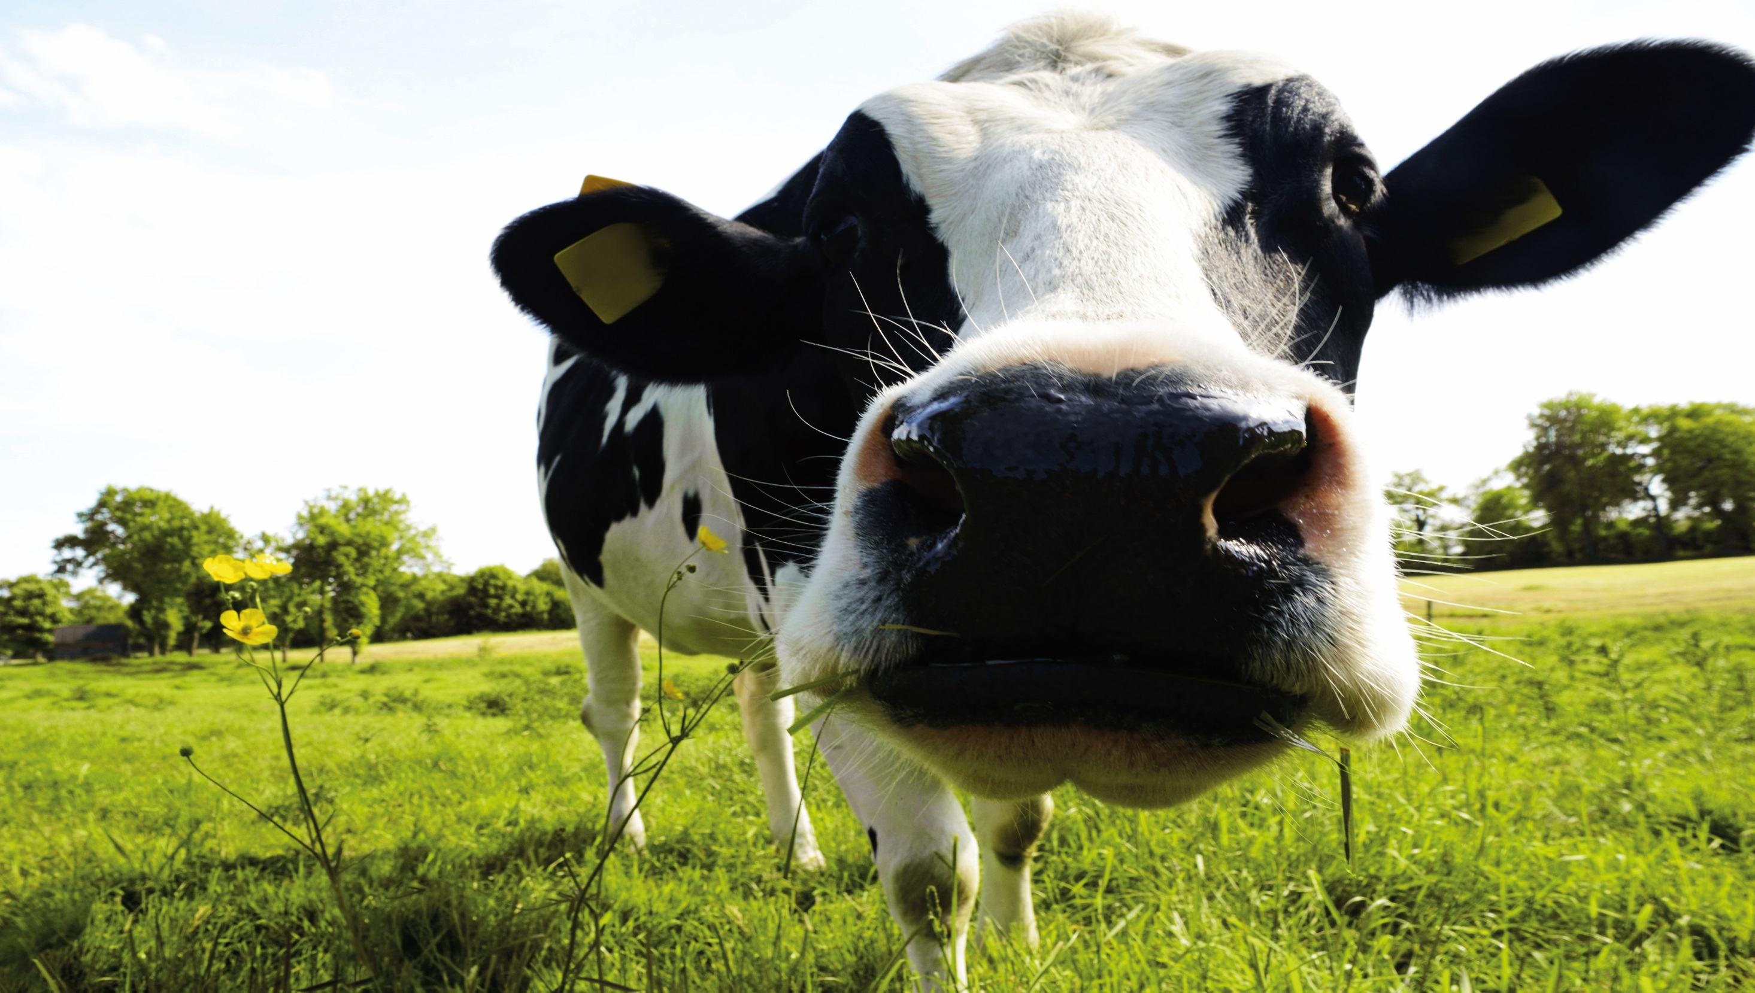
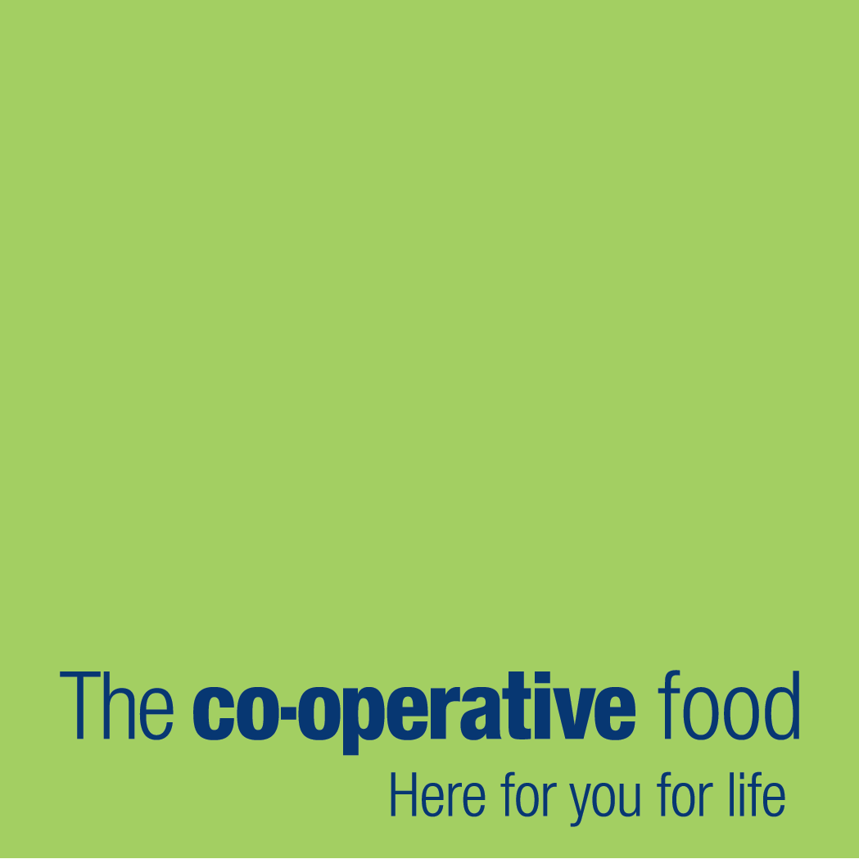
The Co-operative Progress Report on Animal Welfare
and
Farming Groups
V3 – July 2015

Slide 2
Introduction
As part of our business commitment to animal welfare, sourcing British protein and supporting British Farming we will report on our progress. In this document we will be open and honest about where the food we sell comes from, our progress on animal welfare and ongoing development of our Farming Groups.

Slide 3
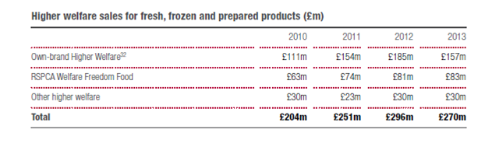
Welfare Standards
All our customers, no matter what their budget, should be able to enjoy meat, poultry and fish knowing it has come from animals reared to good welfare standards.
All own brand meat and poultry products are produced as a minimum to Red Tractor Farm Assurance Scheme standards or equivalent where sourced outside of the UK
In 2013 sales of products from animals reared to higher welfare standards totalled £270m (2012: £296m), with 466 higher welfare lines available in food stores (2012:393). Sales of these products decreased in 2013 as a result of customers trading down from premium range products, changes to product specification and availability of these ranges

Slide 4
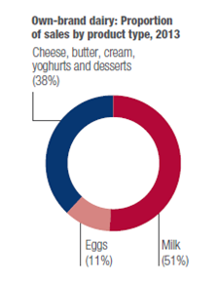
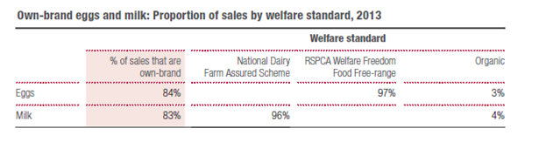
Eggs and Milk
Since 2008 we have only sold free-range or free-range organic shell eggs and since 2010 we have only used free-range egg as an ingredient in own brand products
In 2013, 97% of our own brand shell egg sales were RSPCA Welfare Freedom Food accredited (2012: 98%)
In 2013, 96% of own-brand fresh milk was assured under National Dairy Farm Assurance Scheme (2012: 96%). The remainder was certified as organic by the Soil Association
The Co-operative Dairy Group, the farming group dedicated to supplying the equivalent of approximately 90% of our own brand assured milk, maintains welfare standards, compliance with our grazing policy and audited monitoring of key herd health impacts.

Slide 5
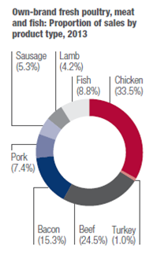
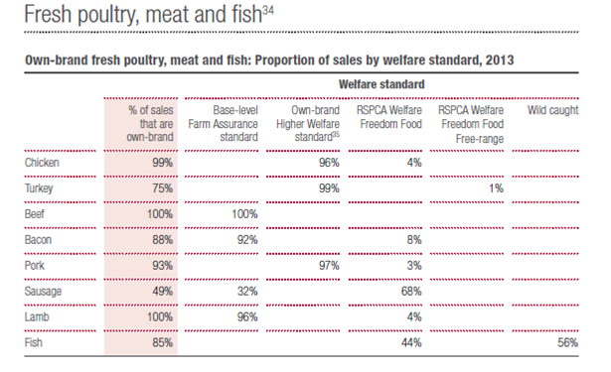
Fresh Poultry, Meat and Fish
Livestock standards for all species are detailed within our animal welfare policy technical standards document
We continue to pursue good welfare standards across our range whilst offering choice for our customer to meet their needs
The table below details the proportion of sales by welfare standard for own brand fresh poultry, meat and fish sold in 2013

Slide 6
Performance on Pre-Slaughter Stunning
Religious Slaughter – Farm Animal Welfare at Slaughter
All meat and poultry sold under The Co-operative brand is produced to strict standards of animal welfare. All own-brand fresh and frozen meat and poultry sold in Co-operative stores has been humanely stunned prior to slaughter, and all abattoirs and processing plants supplying our own-brand products are required to work to the standards laid down by our strict animal welfare requirements as well as the Humane Slaughter Association in their Codes of Practice.
We do not stipulate Halal/Kosher in our product specifications, nor do we currently sell any Halal/Kosher certified meat and all of our meat comes from animals that are pre-stunned. There is currently no UK wide labelling scheme to cover whether an animal has been stunned prior to slaughter and to avoid confusing our customers, we would need a consistent approach across the UK food industry, including food service and catering.
Performance:
100% of animals within our supply chain have been humanely stunned prior to slaughter in 2014-2015
Performance on this measure is audited by our team of dedicated animal welfare specialists and any issues are documented within the relevant documentation in our abattoirs and processing plants.
All abattoirs slaughtering livestock for supply to The Co-operative Group shall have in place a CCTV system for the monitoring and recording of livestock up to the point of kill (including offloading, handling, stunning and sticking) for the purpose of managing animal welfare. The CCTV equipment should be capable of recording legible time and date stamped images and storing these images for a period of not less than 6 months. Footage from this CCTV system is to be checked by senior management on a routine basis and be available for audit by a representative from The Co-operative or an appointed agent/audit body at any time

Slide 7
Performance on live transport times for animals
Travelling Distance and Time
We ensure our supply base keep live animal transportation to a minimum and avoid unnecessary long distance travel. We specify specific transportation limits with each livestock standard. Overall a maximum transport time of 8 hours is permitted across our supply chain with key targets in place for all species. This data is reviewed though monthly data collection from our supply chain which is uploaded onto our animal welfare portal called Pyramid. We have previously been awarded RSPCA Hot Topic Award (Live animal transportation times) for our standards on transportation within our supply chain.
Performance:
98% of animals within our own brand supply chain through our farming groups have met our target for live animal transportation times.
Performance on this measure is audited by our team of dedicated animal welfare specialists and any issues are documented within the relevant documentation in our abattoirs and processing plants.
Issue Management
In 2014 we had an two issues where slaughter at two production sites had to be suspended. A decision was taken jointly with the onsite vet to extend the travel time until production was re-started in order to maintain the welfare of the birds and livestock.

Slide 8
Performance of farm indicator measurements
On a monthly basis we record input, outcome and health and quality measures from the farms within our Farming Group. We have set criteria and an agreed target for each species that our farmers and suppliers work to. This enables the us to show due diligence against our animal welfare targets but more importantly drives progress and action to any challenges for our farming and supplier base. Our welfare tracker is reviewed monthly by our team of dedicated experts in animal welfare. We feedback performance through farming group meetings so that individual farmers can see how they benchmark against the group and help drive further improvements and share best practice in in a practical manner. Our suppliers and farmers can review their performance and benchmark themselves against the wider farming base on our our Pyramid system.
Performance:
We committed to reporting on our performance against our animal welfare measures within 2015. Our performance for input, outcome and quality measures is detailed on the following page

Slide 9
Performance of farm indicator measurements in 2014
The table above details the % compliance of our supply chain for input, outcome and quality measures within 2014. This data is recorded for each species from our Farming Group farms on a monthly basis. Typical input measures include stocking density, medicine usage, travel times and days grazing. Typical outcome measures include body condition, hockburn, pododermatitis, mastitis, leg culls, condemnations, lameness, , tail docking and mortality. Typical quality and consistency measures include factory condemnations, disease incidence, bruising, microbiological performance. Bactoscan, carcase grade and live weight. Performance is reported on a monthly basis internally and action plans to improve performance on farm and through R&D are in place with all suppliers.

Slide 10
Progress on Farming Groups
Introduction
The Co-operative Food supports nearly 2,000 UK farmers and has dedicated long term relationships with over 400 carefully selected farmers, collectively known as The Co-operative Farming Groups. These 400 carefully selected farmers across key species are called foundation farms. They are focussed on growing and rearing The Co-operative’s fresh protein with passion to the standards you expect. They provide chicken, pork, Hereford and Aberdeen Angus beef, Cambrian lamb and milk through a transparent supply chain.
Since the establishment of our Co-operative Dairy Group in 2011, we launched five additional Farming Groups for farmers supplying our own-brand fresh British meat and poultry. The six groups are helping to maintain The Co-operative’s strict animal welfare policies and encourage long-term investment and improvements to farm efficiencies, training and sustainability.
Current Farming Groups
The Co-operative Chicken Group
The Co-operative Dairy Group
The Co-operative Pork Group – 2 groups within
The Co-operative Beef Group – Hereford & Aberdeen Angus
The Co-operative Cambrian Lamb Group
Farming Groups Under Development
The Co-operative Egg Laying Group
The Co-operative Turkey Group
The Co-operative Beef Group – standard supply
The Co-operative Lamb Group – standard supply

